Slide 1
Fast and Efficient Cross Band Channel Prediction Using Machine Learning
by
Arjun Bakshi
Yifan Mao
Kannan Srinivasan
Srinivasan Parthasarathy
The Ohio State University
Notes:
Hello ….. My name is _ and I’m a final year PhD candidate at OSU.
In this talk I’m going to present my work on cross band channel prediction using machine learning.

Slide 2
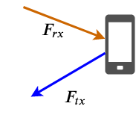
Frequency Division Duplex Systems
Device knows channel on F_{rx} but not on F_{tx}
Device needs channel on F_{tx} for,
Power selection,
Rate selection...
Typical solution:
Get feedback. Channel in F_{tx} band is sent by other node as a message
Alternative approach: Predict channel on F_{tx} from that in F_{rx}
Notes:
In this work, we look at the wireless channel in frequency division duplex systems, where a device transmits in on band and receives in another band

Slide 3
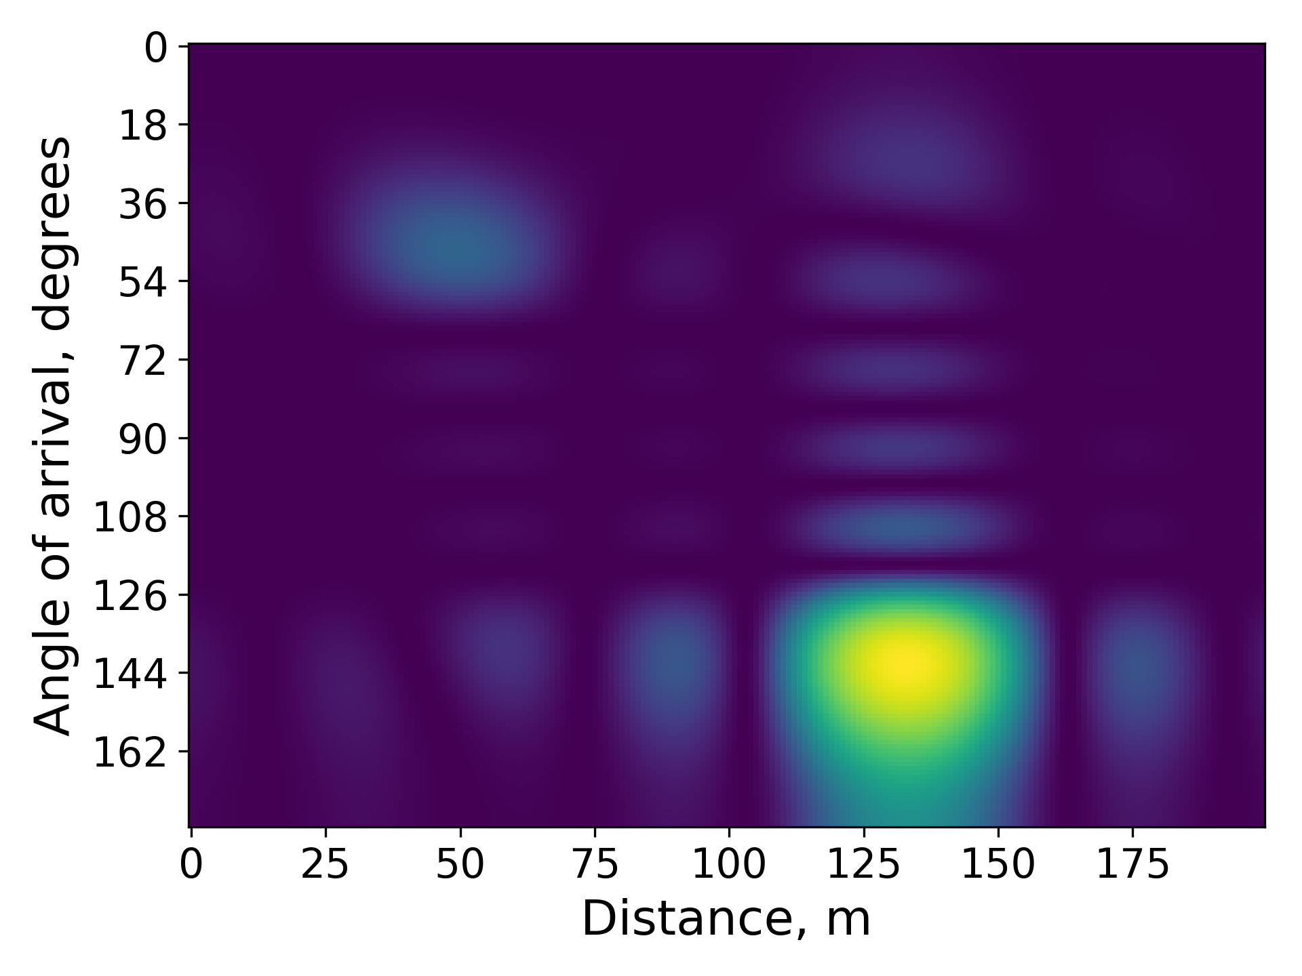
Primer on Channel Prediction
JADE: Joint Angle and delay estimation systems, like R2F2, SI-JADE
Step 1: Map channel on F_{rx} to coarse estimates of underlying physical parameters
Step 2: Refine the estimates through an optimization
Step 3: Calculate channel on F_{tx} using refined physical parameter

Slide 4
R2F2: Channel Prediction State of the Art
A JADE system: Estimates AoA, delay, attenuation of underlying components for FDD channel prediction
Very accurate, but…
Poor initialization may lead to poor results
Not suitable for personal devices
High computational complexity
Need for linear antenna array
Notes:
The optimization in R2F2 is non-convex and needs to be initialized properly
This heatmap show the likelihood of the channel containing components from different distances and AoAs
The distance of about 130m is clearly a good guess, but ...
...the channel contains a second component around 40 meters which is not highlighted in this heatmap
There are also many false positives in this approach for generating initial estimates
Lastly, due to its high complexity...

Slide 5
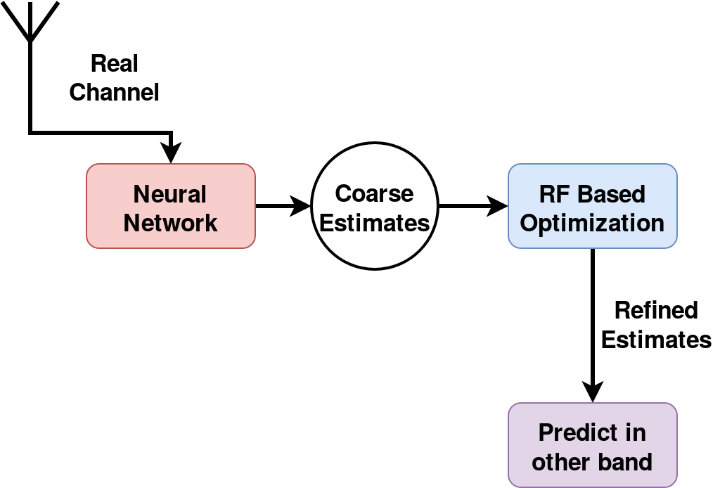
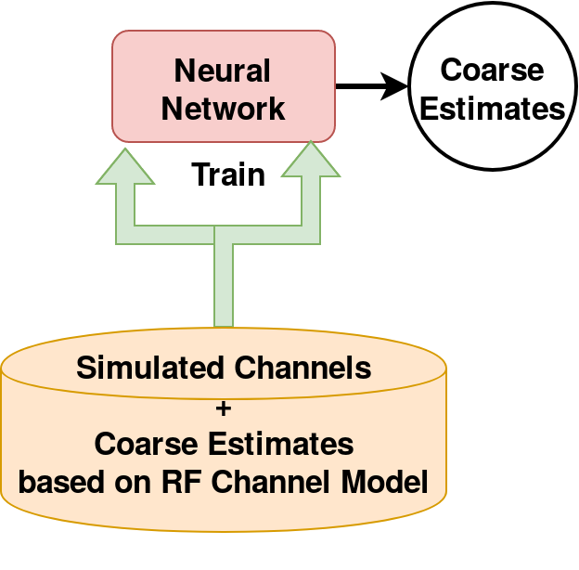
OptML: Machine Learning Aided Channel
Prediction
Train neural network on RF channel model
Leverage domain knowledge and ML
Generates high quality initial estimates
Refined by JADE-like optimization
Fast and efficient: 10x-100x faster
Works on single antenna systems
Flexible design

Slide 6
OptML: Initial Guess Generation
Neural Network Distance Estimator (NNDE)
Trained on synthetic data:
Based on a standard RF channel model
Input: Channel observed by one antenna
Output: Coarse estimates
Single antenna
→ No angular resolution
→ Distance or delay estimates only
Notes:
To generate high quality guesses, we model the problem as a supervised learning task.
We train a neural network where the input is the channel observed at an antenna
And the output represents the initial estimates

Slide 7
OptML: Initial Guess Generation
Input data generation:
Simulated channels based on physical channel model
Parameters:
n, number of components, [1, N_{max}]
d_{n}, distances, [0 to d_{max}]
a_{n} , attenuations, (0,1]
ɸ_{n} , phase offset, [0, 2π]

Slide 8
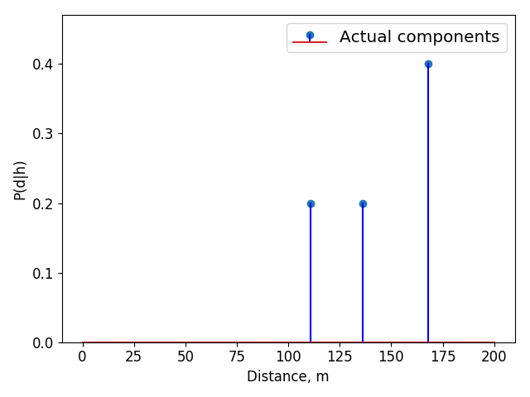
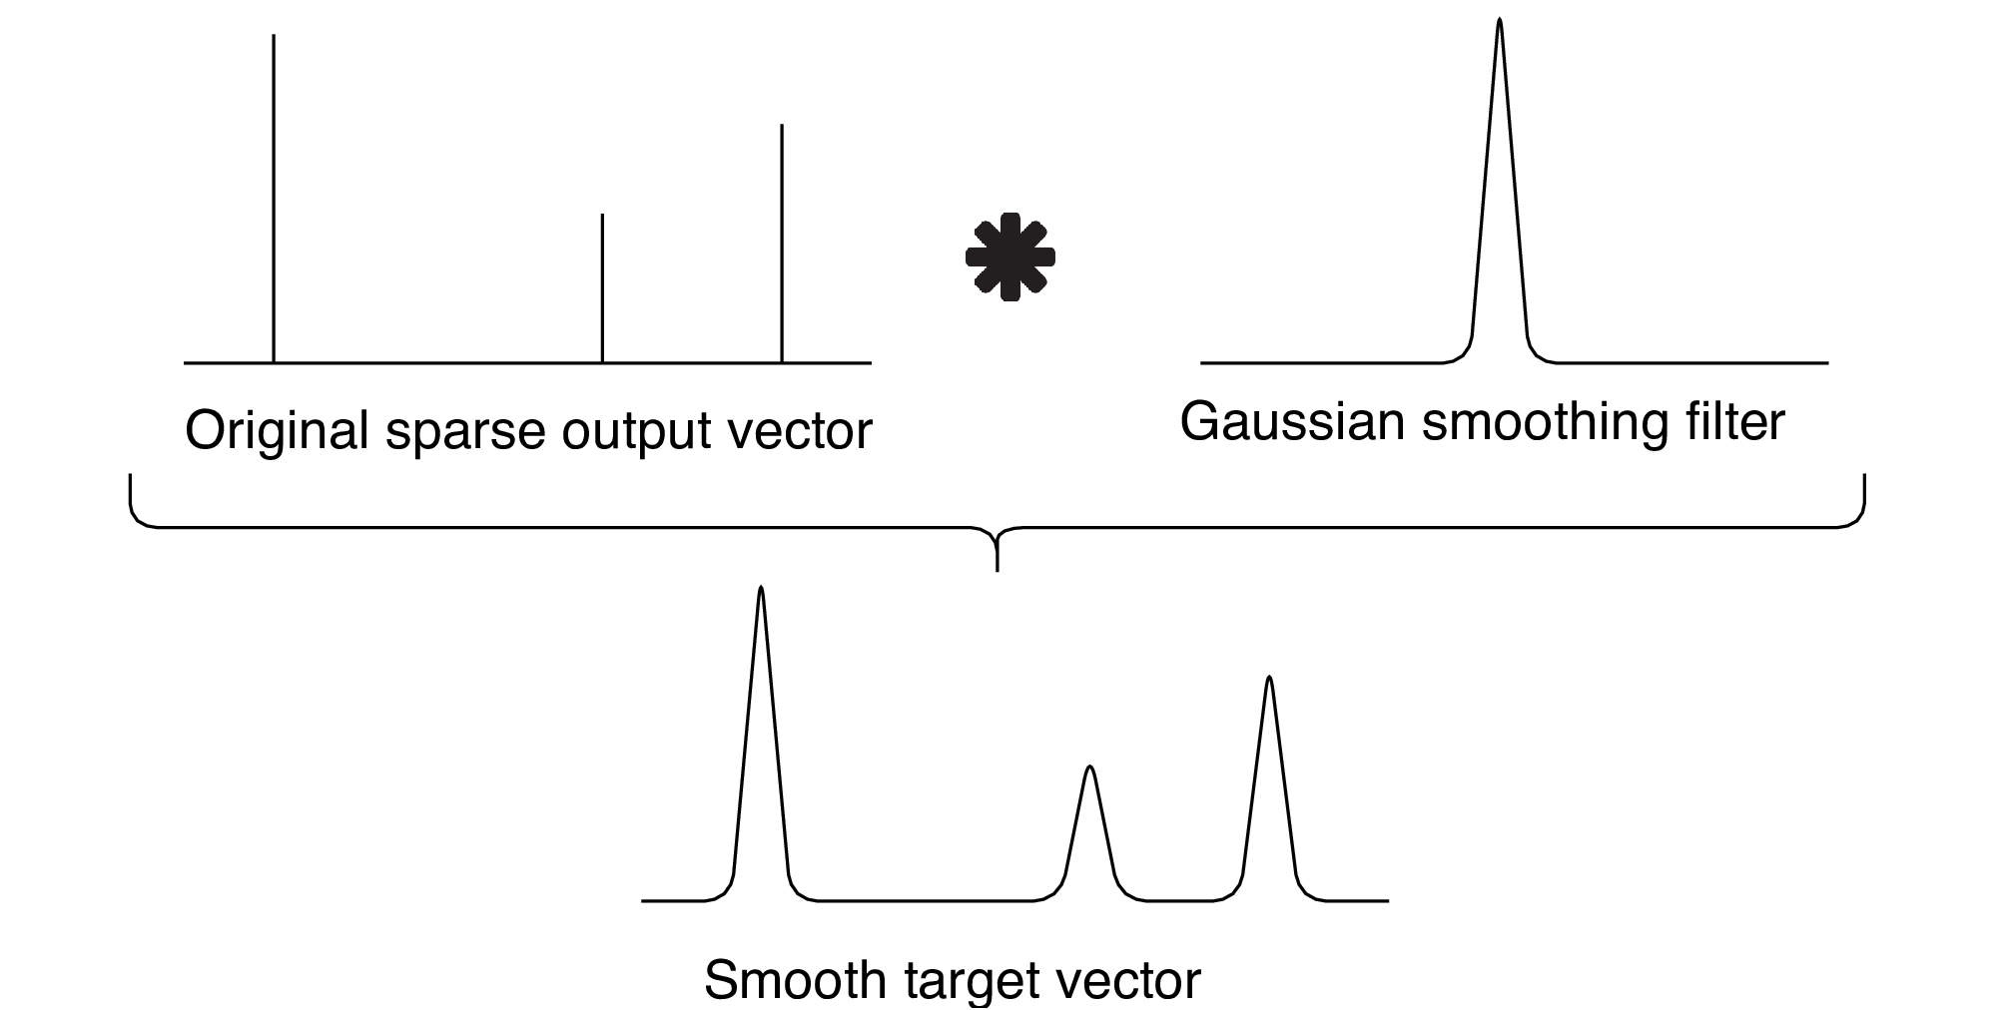
OptML: Initial Guess Generation
Target output generation
Precise and no false positives
Ideal target (extremely sparse)
Reduce sparsity with smoothing
Notes:
The ideal output is extremely sparse as only a few bins would have non-zero values
As sparse outputs can be harder to train for, we reduce the sparsity by convolving the original sparse output with a gaussian smoothing filter
and use that at the target output for the neural network

Slide 9
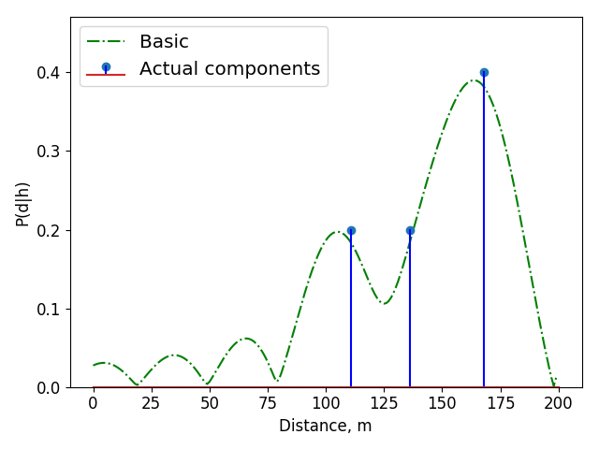
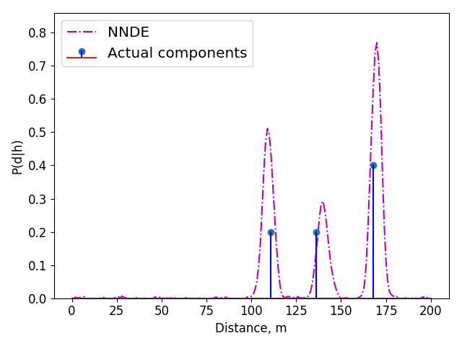
OptML: Initial Guess Generation
Train fully connected neural network (10 layers, 200 units each, ELU)
Sample output Raw resolution Estimator vs Neural Network Distance Estimator (NNDE)
Implications for optimization step:
-- Tight bounds on variable ranges
-- Reduced search space
-- One shot initialization
Resolved
Missing one
False positives
No false positives
Raw resolution (Basic) estimator
NNDE
Notes:
Here we see a comparison of the basis estimator and the NNDE
Unlike the basic estimator, the NNDE can idenify the two weaker components easily
And has no false positives

Slide 10
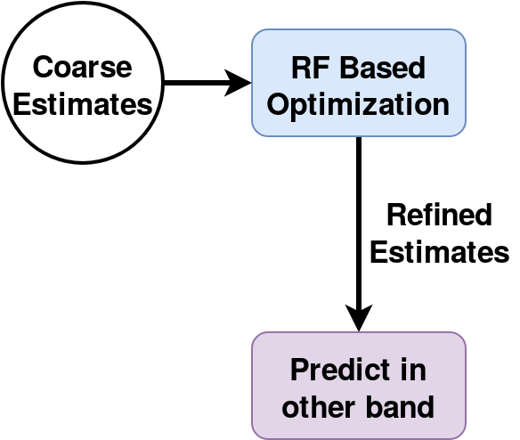
OptML: Refining Estimates
NNDE outputs coarse estimates: {d_{n}}
Simple and efficient optimization to refine {d_{n}}
Minimize the difference between observed channel and channel due to {d_{n}}:
where
H_{rx} is the channel observed in F_{rx}
D is a matrix based on {d_{n}}
D⁺ is the pseudo-inverse of D

Slide 11
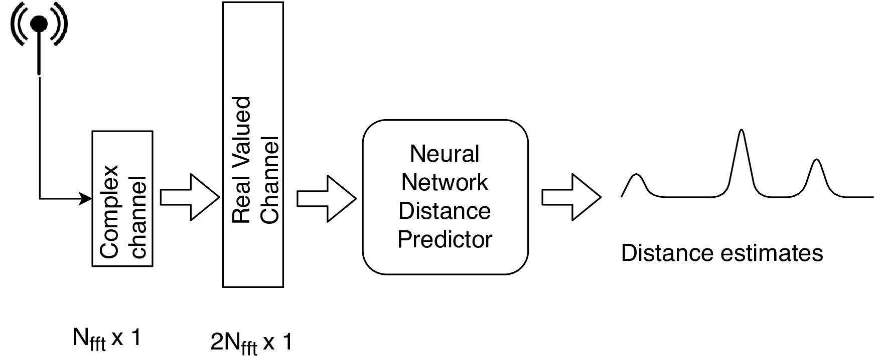
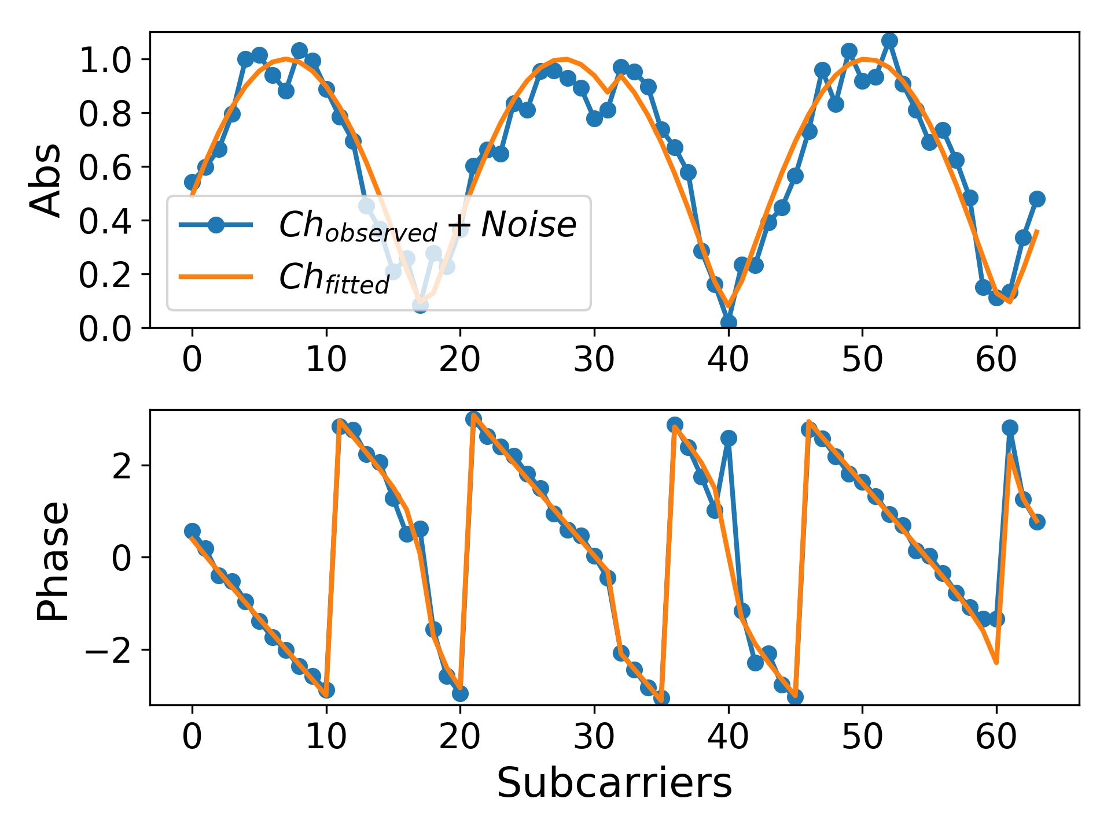
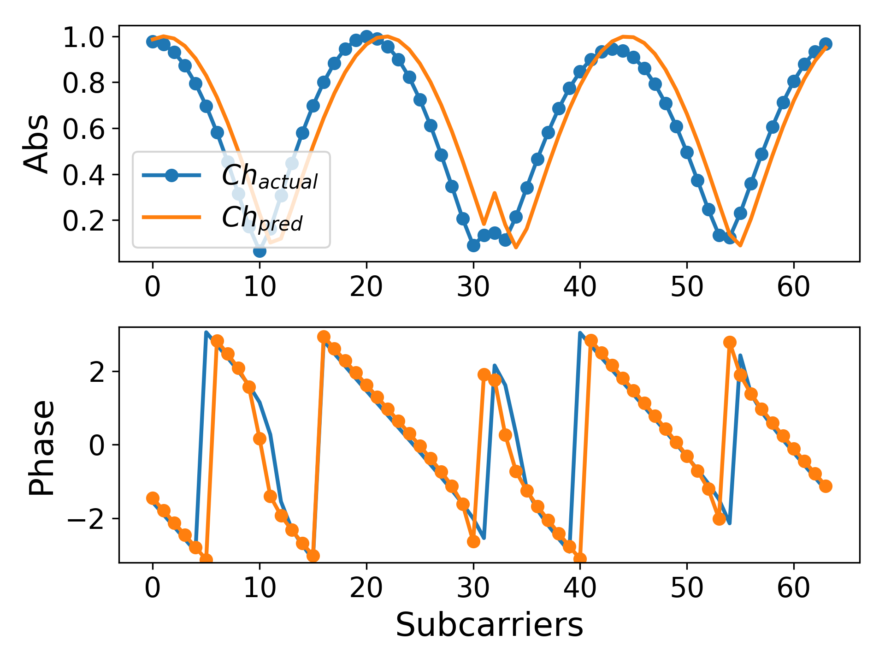
OptML: Summary of Key Steps
Generate Initial Guesses
Optimization Framework
Calculate channel in other band
Fine tune parameter estimates
Fit observed channel
Notes:
So to recap...

Slide 12
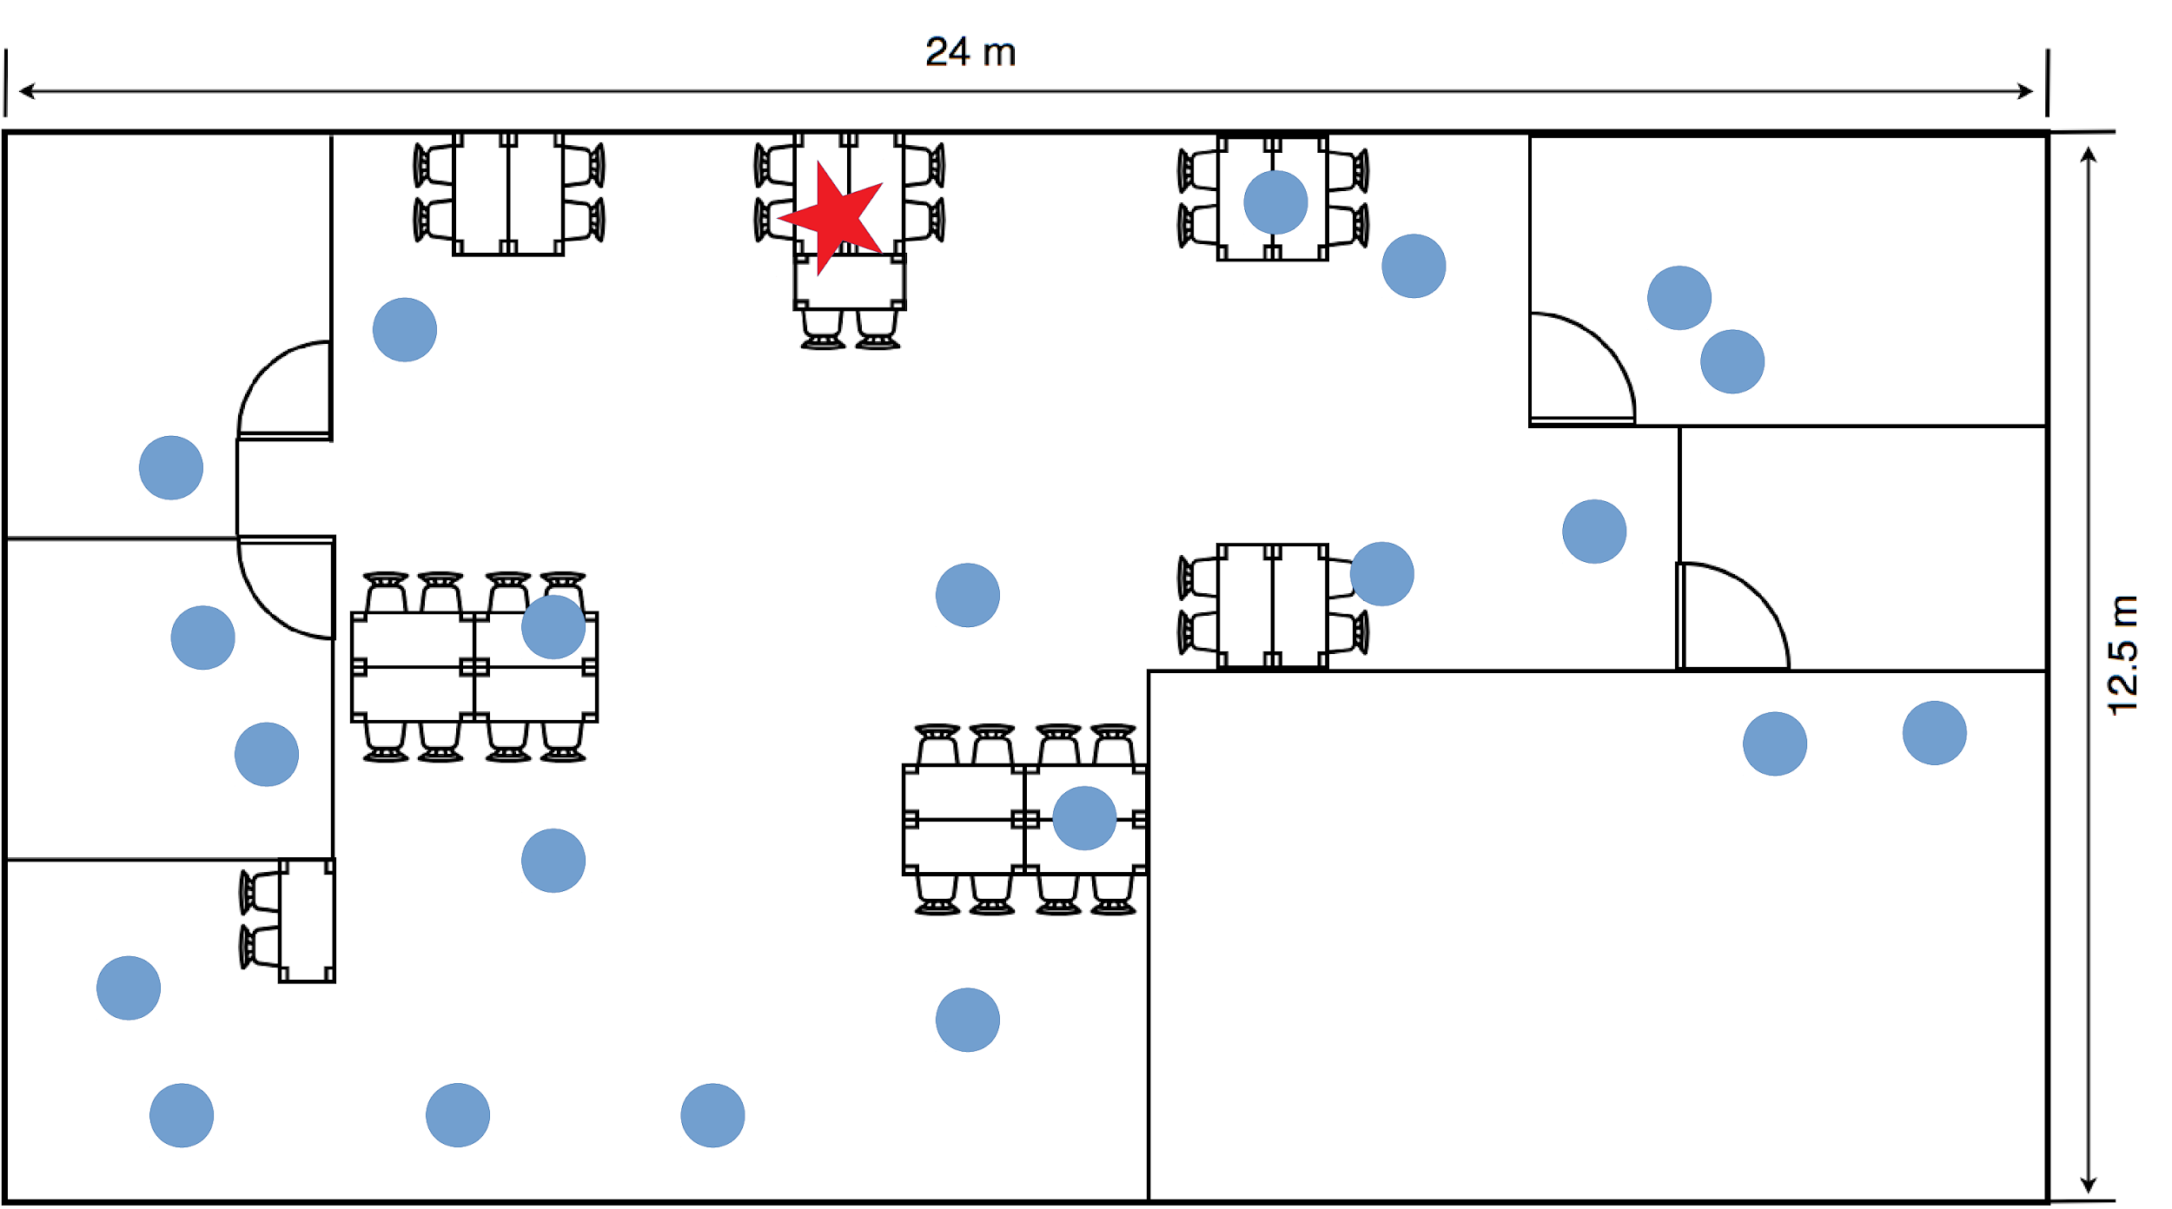
Evaluation: Indoor experiments
Indoor experiments:
3 antenna base station and 1 antenna client using USRP N210
Measure in 10MHz around 2.42GHz
Predict in 10MHz around 2.45GHz
Simulations
Larger antenna arrays
Beamforming to measure prediction accuracy
Runtime comparison
Notes:
We evaluate OptML in an indoor testbed using a 3 antenna base station and 1 antenna client using usrp N210s
We compare the performance of OptML to R2F2
For the purposes of the experiments, we use the wifi band,
We measure the channel over 10MHz centered arounf 2.42GHz and predict it over 10MHZ in the 2.45GHz band

Slide 13
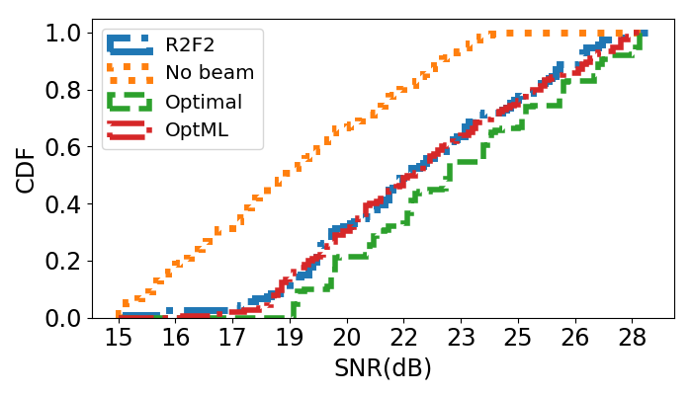
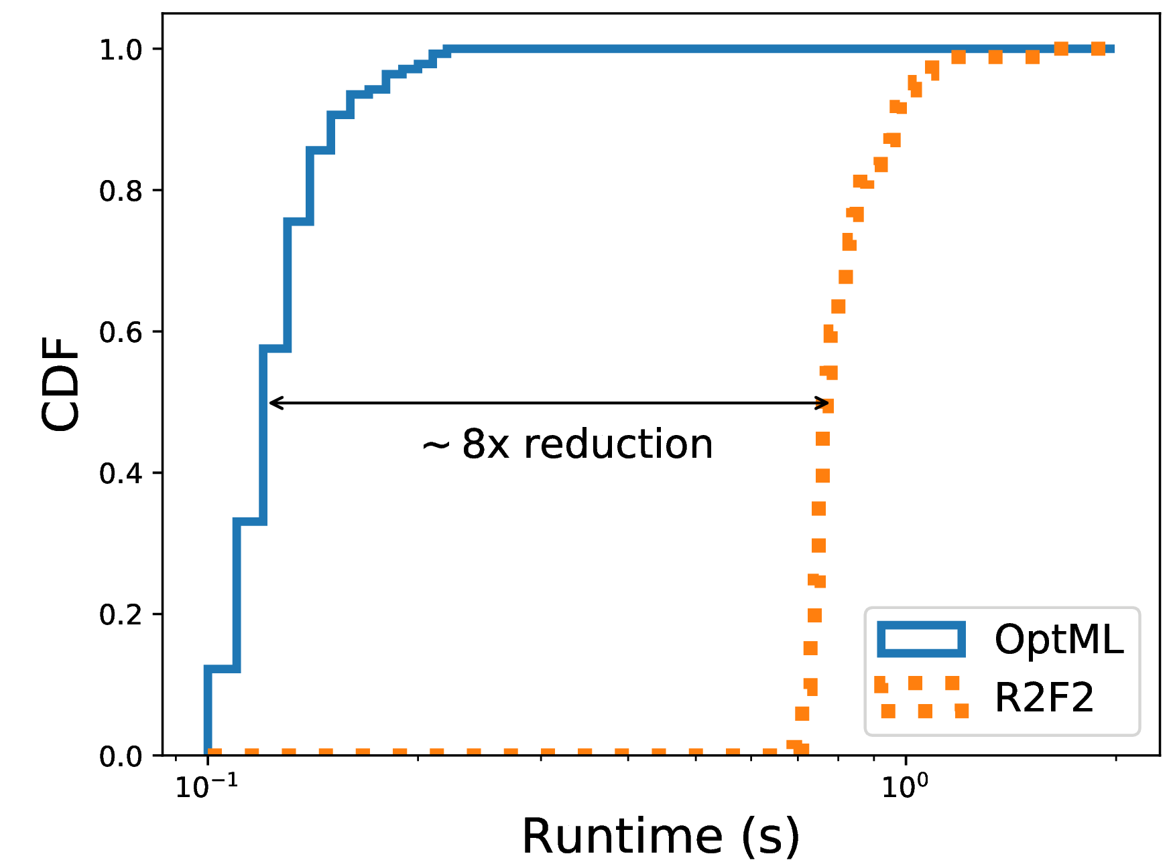
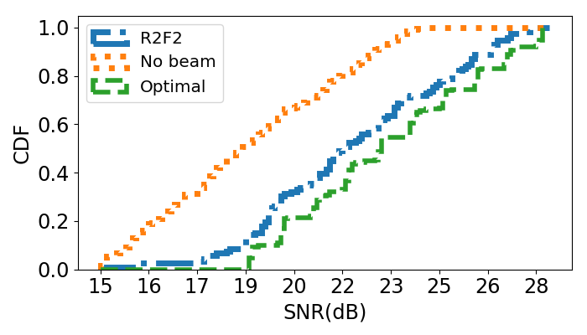
Evaluation: Indoor experiments
Beamforming:
R2F2 is within 1dB of optimal performance
~8x faster, including:
Guess generation
Optimization
Order of magnitude faster
+
Match beamforming performance.
Reason → Better estimates + Tighter bounds from NNDE
OptML closely follows R2F2

Slide 14
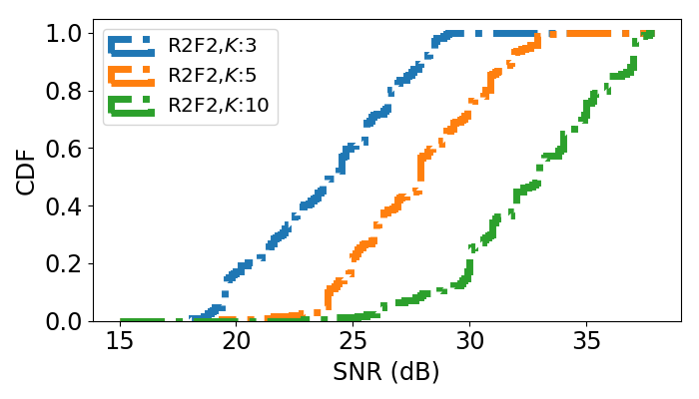
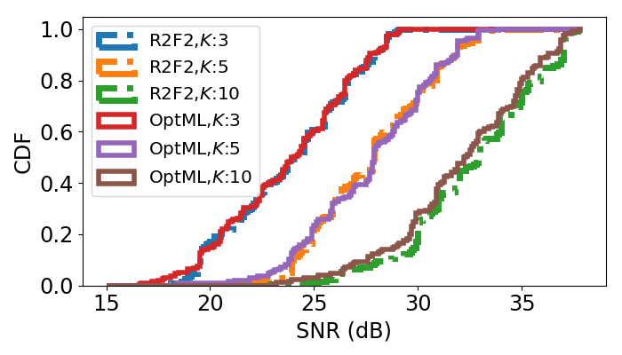
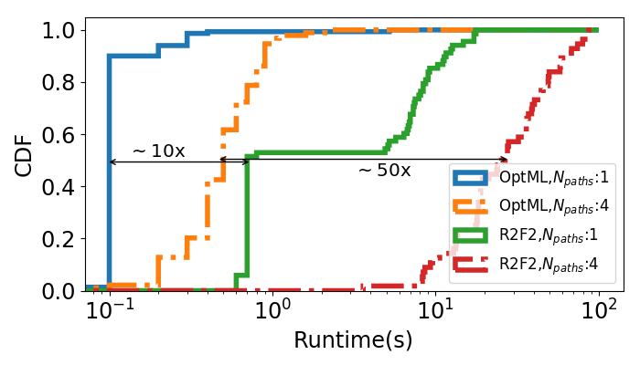
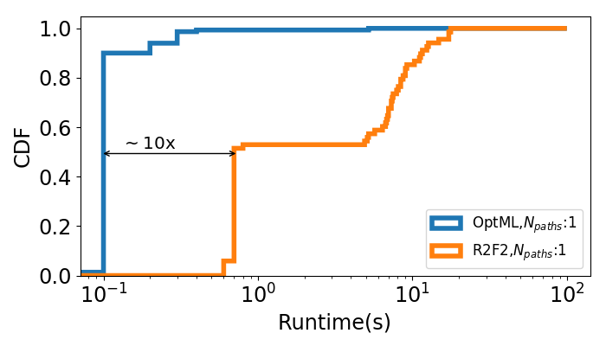
Evaluation: Simulations
R2F2’s beamforming gain increases as array size (K) increases
Similar speed up as indoor experiments
Greater speedup as the number of multipath components increases
OptML follows closely
Notes:
We see that the beamforming gains of both approaches increase as the number of antennas increase
which is in line with expectation...

Slide 15
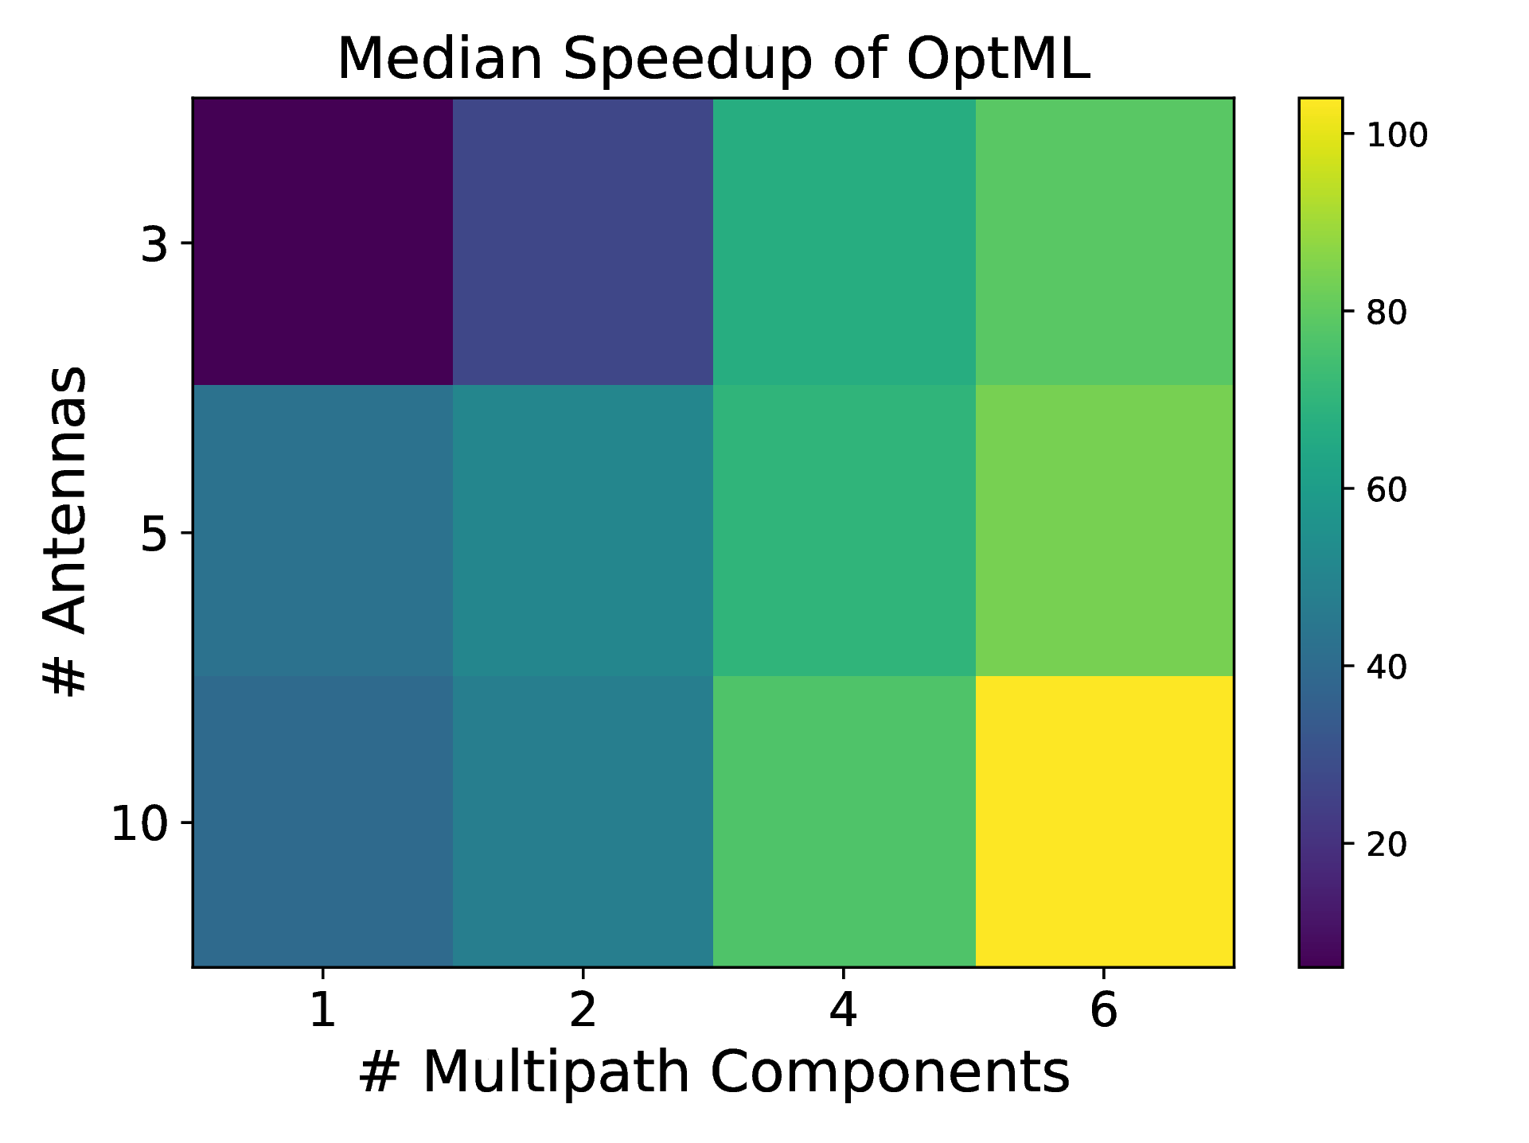
Evaluation: Simulations
Relative speed up increases as:
Number of antennas increases
Number of multipath components increase
Notes:
Next, we look at how the runtime changes for each approach as the number of components and antennas increase

Slide 16
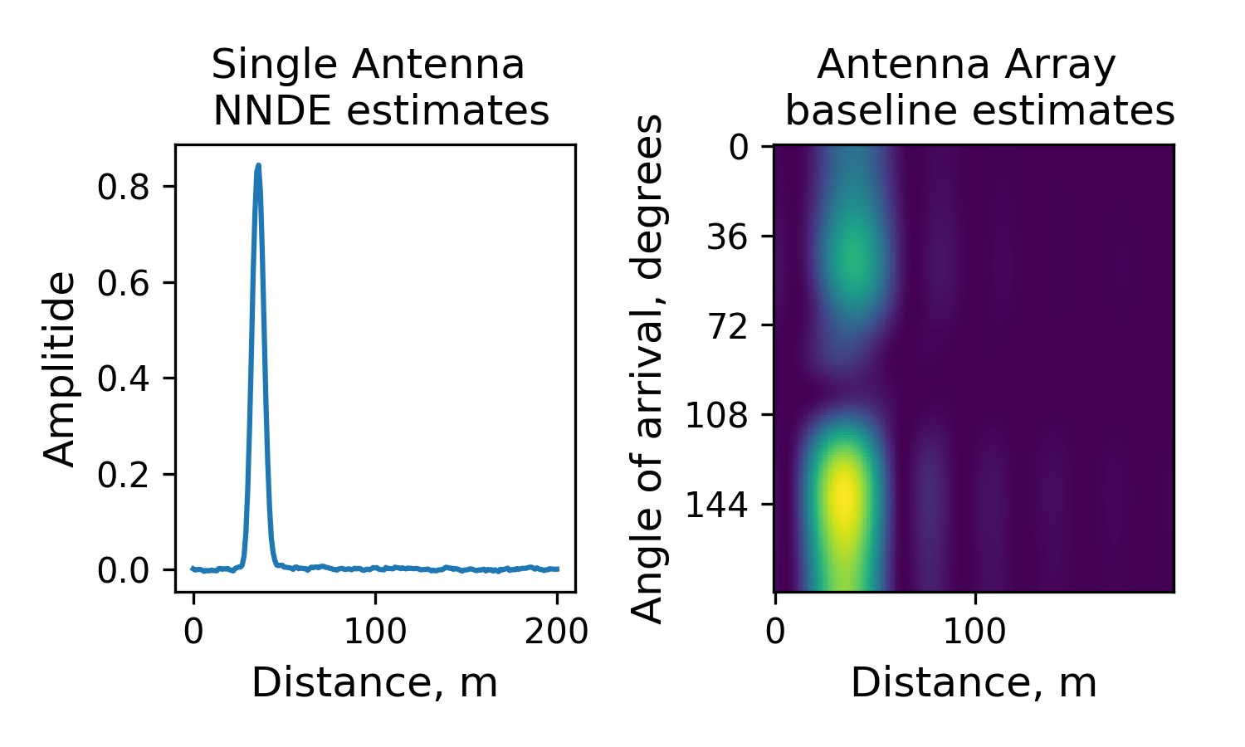
Limitations
Loss of Angular Resolution: Initial guesses can not resolve components with very similar distances but different angles of arrival
Future work: JADE + ML hybrid techniques
Extend to antenna arrays
Speed up existing channel prediction systems
Notes:
Move future work improvements to this slide

Slide 17
Conclusion
OptML provides 10-100x speed up, and matches performance of current state of the art technique:
Efficient enough to work on many types of devices
Shows the promise of ML in RF super-resolution:
Applications to localization, sensing, tracking etc.

Slide 18
Thank you
Q&A
This work is supported by
The National Science Foundation
and
The Office of Naval Research

